Slide 1
Event Study Methodology
Seoul National University 2019 spring

Slide 2
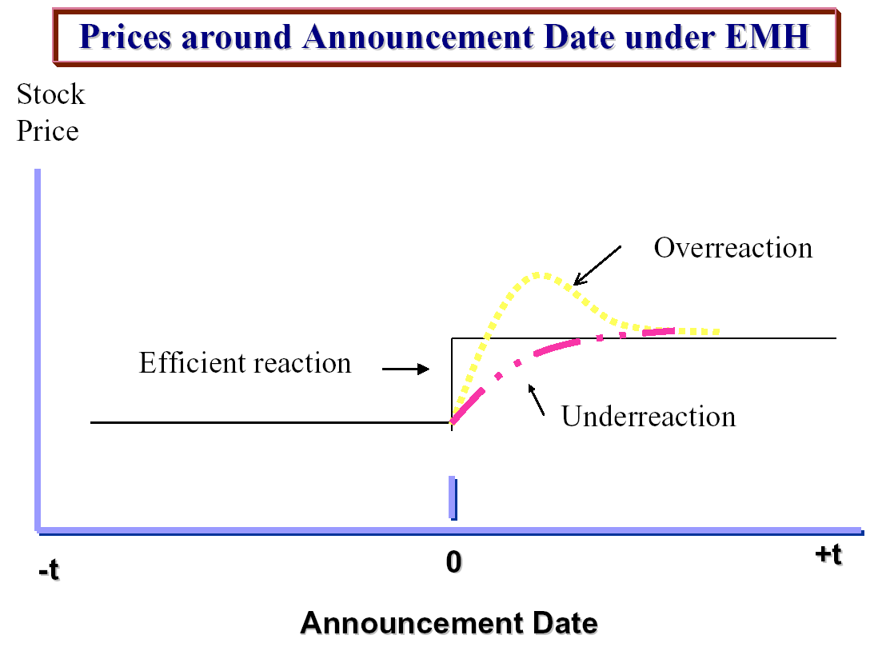

Slide 3
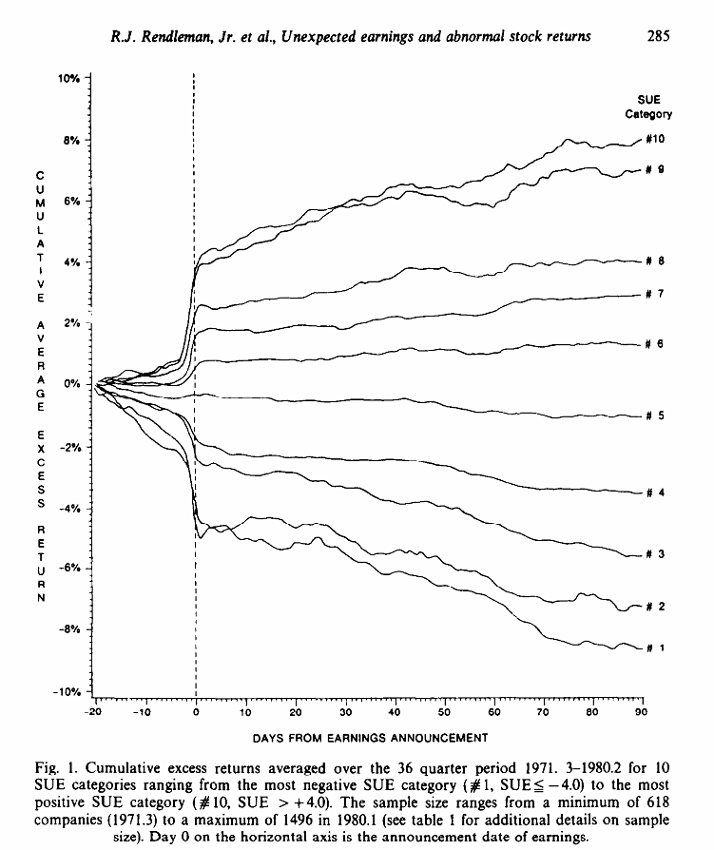

Slide 4
An event study measures the impact of a specific event on the value of the firm
Relies on market efficiency
Main Issue
  Announcement Day
  Event Window
  Benchmark (Expected Return)

Slide 5
Event Study vs. Accounting Measures
Event study advantages
  Expected effects of event will be reflected immediately in security prices, while may take months or years for effects to show in productivity measures
  Takes risk into account, while accounting measures do not
  Accounting conventions vary across firms
  Accounting measures could be manipulated
Accounting measure advantages
  Simpler to use
  Can be used for any firm publishing accounts
  Event study can be sensitive to model used

Slide 6
Event Window
Some information about the event may have leaked out beforehand, and sometimes it takes time for the market to fully react to an event
Trade-off between short and long windows
  Not all information about the event may be captured if short window
  Information irrelevant to the event more likely to be captured if long window
  Results less sensitive to model choice with short window

Slide 7
Abnormal Return
AR_{it} = R_{it} – E(R_{it}|X_{it})
R_{it} is the actual return
X_{it} is the conditioning information

Slide 8
Market Model (Market and risk Adjusted Return Model)
E(R_{it}) = α_{i}+ β_{i}R_{mt}
AR_{it} = R_{it} – (α_{i}+ β_{i}R_{mt})
α is the average return of the firm compared to the market average
β is the sensitivity of this firm’s return to the market return, i.e., the market risk of this stock
Takes both market trends and firm’s risk into account

Slide 9
Capital Asset Pricing Model
E(R_{it}) = R_{ft}+ β_{i}(R_{mt} – R_{ft})
AR_{it} = R_{it} – [R_{ft}+ β_{i}(R_{mt} – R_{ft})]
R_{ft} is the risk-free interest rate (usually short-term government bond)
Commonly used in event studies in 1970’s
Deviations from CAPM have been discovered since then, implying validity of CAPM’s restrictions on market model is questionable

Slide 10
Parameter Estimation for MM and CAPM
Most studies select period prior to event, ending sometime before beginning of event window
Some studies also include period after event, to allow for change in risk caused by the event
Often use 60 monthly observations
Some recent studies use daily data
The more observations used across time, the greater the statistical accuracy of the beta
Alpha and beta can change over time

Slide 11
Fama and French Three Factor Model
E(R_{it}) = R_{ft}+ β_{i}(R_{mt} – R_{ft}) + h_{i}HML_{t} + s_{i}SMB_{t}
AR_{it} = R_{it} - [R_{ft}+ β_{i}(R_{mt} – R_{ft}) + h_{i}HML_{t} + s_{i}SMB_{t} ]
HML is return on mimicking portfolio for book-to-market factor
SMB is return on mimicking portfolio for the size factor

Slide 12
Reference Portfolio
Select reference portfolio of stocks that are similar according to size, book-to-market ratio, or industry
The return on the reference portfolio is the expected return

Slide 13
Matching with Control Firms
Select control firm not undergoing the event for each firm undergoing the event, based on characteristics such as size, book-to-market, and industry
The return on the control firm is the expected return

Slide 14
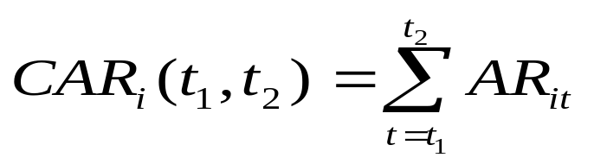
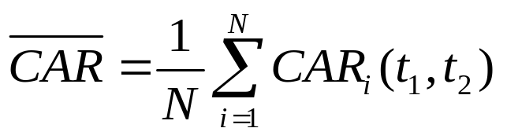
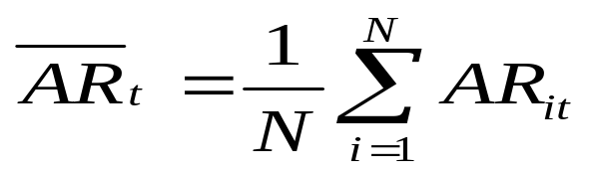
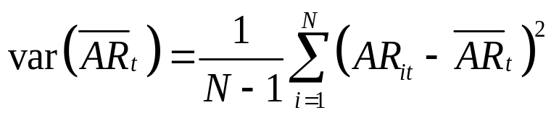
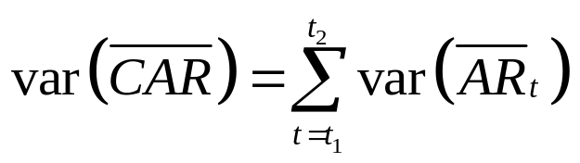
Cumulative Abnormal Returns

Slide 15
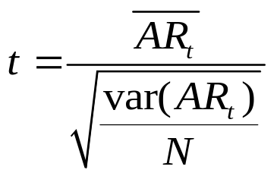

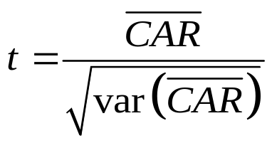
t-test for significance
Test statistic for ARt
  t is distributed Student-t with N degrees of freedom
Test statistic for
More sophisticated methods sometimes used

Slide 16
Differences Across Studies
Use different models for estimating expected returns
Use different periods for calculating model parameters
Use different periods for calculating CARs
Different methods/models can give different results

